Slide 1

Service Management Automation (SMA) Suite Technical Presentation Training, Level 320 Module 1 – Customer Facing Presentation
Carol Hibbard
You can:
Download the presentation.
Download PowerPoint slides & speaker notes.
October 2018
Notes:
[STANDARD SLIDE: L300 (animated)]
You can change out the photo with any image from Getty Images in DropBox.
If the main title is shorter, you can make the font larger.
You may have to move the title text around depending on the photo. Make sure the text is readable against the background photo.
You can change the background color for the rectangle in the bottom-right corner to look better against the background. Choose a Micro Focus color at 25% transparency.
=========================
Note to Narrator or Reader: [PRESS] indicates press the Page Down key to show the animation
=========================
Hello and Welcome to the [COURSE_NAME] Technical Overview Training, Level 300.
In this course you’ll gain a high-level understanding of the essentials of [PRODUCT_NAME].
[PRESS] If you want to download this presentation and save it on your own system, click the Tools & Help icon in the bottom-right corner of your Brainshark window and select Download.
Or, if you want to access the PPT slides and speaker notes for future reference, go to the Attachments tab in Brainshark and click to download the presentation.

Slide 2
Introduction to the 300-Series Curriculum
What is the 300-series Curriculum?
300
L300
L320
L340
L360-380
Notes:
[STANDARD SLIDE: L300 (animated)]
The position of the LIGHT BLUE rectangle identifies the level of the current course.
The 300-series curriculum focuses on product knowledge and experience: from foundation-level concepts to hands-on operation in a live environment.
The curriculum spans Level-300 courses all the way through Level-380 courses.
[PRESS ONLY ONCE AS IMAGES APPEAR ACROSS THE SCREEN] The Level-300 course is the FIRST step in the 300-Series training curriculum.
It provides a foundational overview of the suite without diving deeply into individual product capabilities and operation.

Slide 3
About this Course
You will learn
Capabilities
Key takeaways
Recommended
Pre-study
Certification
How to deliver the SMA Customer Facing Presentation
How to deliver the SMA Technical Customer Facing Presentation
Techniques to handle objections.
How to differentiate Micro Focus SMA from our competitors.
Value proposition
Differentiating features
Technical features
Objection handling
Competitive differentiation
Value proposition and Customer success stories
Features
Objection handling
Competitive differentiators
L110 to L150
L210 to L240
L300
Take the certification exam.

Slide 4
SMA Customer Facing Presentation (CFP)
Value proposition
Key customer outcomes
Differentiating features

Slide 5

Service Management Automation Value
Challenges
Requirements
Outcomes
Slow and unresponsive service desk
Service desk based on analytics and machine learning
Lower ticket volumes, higher productivity
Comprehensive easy to use self-service with a modern experience
Increased user autonomy and satisfaction
Dissatisfied users
Manual, inefficient, error-prone tasks
Automation and best practices
Better staff utilization, service quality, and service levels
Expensive setup and maintenance
Codeless configuration for out-of-the-box and user-defined processes
Fast and easy upgrades at low TCO
SaaS or on-premise vendor lock-in
Multi-tenancy support for service providers
Data sovereignty across physical, virtual and cloud environments
High deployment and integration costs
Single platform across ITOM
Flexible deployment options and quick time to value

Slide 6

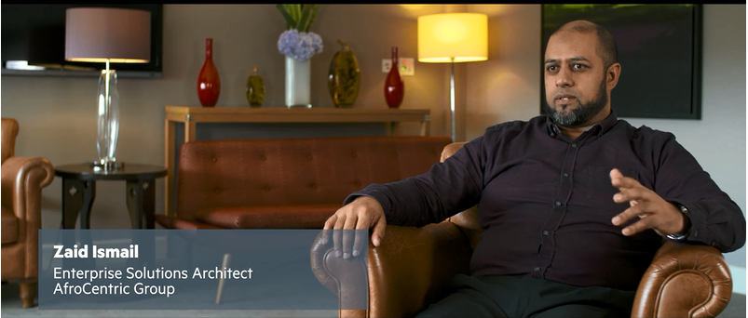
Customer story: Service Management Automation Enables Faster Time-to-market
Challenge
Result
Multiple points of entry to different support areas, solution that consolidate all disparate support channels across the group, something with high visibility and easy to use
Flexible and scalable service management
Understand trends and impact of failures
Mind shift from IT management to risk management
Video: AfroCentric Makes the Move to Enterprise-wide Service Management
Service management becomes relevant across the enterprise, not just within IT. For me that has probably been the best outcome we could have hoped for.
Zaid Ismail, AfroCentric Group
Notes:
NOTE: this is a SMA – Service Manager customer

Slide 7
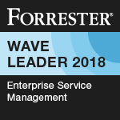
Service Management Automation
Innovative architecture, built for agility and scale
Machine learning and analytics based service desk
Smart self-service with social collaboration
Modern user experience for enterprise applications
Codeless configuration and easy upgrades
Multi-tenancy for service provider support
ITOM platform with flexible deployment options
Mobile
Chatbots
Smart Email
Portal
SMA Studio
ITSM
ITAM
ESM
Automation & Orchestration
Machine Learning & Analytics
Configuration Management
Discovery
ITOM Platform
Physical
Virtual
Cloud
Container
Notes:
[NOTE: Some of the capabilities described here are only available with SMAX. See slides 15 and 16 for details]
As discussed before, today’s IT service desks are complex and costly: slow responses, frustrated users who bypass the service desk, manual processes, high maintenance effort and no choice of deployment. How can Service Management Automation help with this situation?
SMA is the first application suite for IT Service Management, IT Asset Management, and Enterprise Service Management built on a single platform, based on machine learning and analytics, and integrated with CMDB and Discovery. Built on container technology, it can be deployed anywhere (private or public cloud). Its scalable multi-tenant architecture with deployment either on premise or cloud makes it easy to install, configure, and run.
Service desk built upon analytics and machine learning provides capabilities like Smart Ticket, which uses an Optical Character Recognition (OCR) and machine learning system to automatically accept and route service requests. Virtual agents provide automated assistance with integrated live-chat or email to enhance continuous customer support. Hot Topic Analytics uses advanced search and analytics capabilities to enable you to view and analyze patterns in incidents, requests, and other records and to create knowledge articles or problem records based on those patterns. Change Analytics feature offers insights based on the available data, and suggestions for improvements in change management. Collaboration via ChatOps allows to share knowledge across teams for fast issue resolution.
Smart self-service with social collaboration Social collaboration features including ability to vote, "ask a friend," or survey to help end-users source answers from the community and enhance end-user autonomy. On-the-fly translation provides end users with access to portal content and service desk updates in their preferred language: Native mobile applications on Android and iOS complement the web service portal with a streamlined, native interface that focuses on key tasks that need to be managed on the go.
Modern user experience for enterprise applications SMA includes a comprehensive set of ITIL aligned Service Management applications including Service Request Management, Incident Management, Problem Management, Change Management, Release Management, Service Level Management and Configuration Management. Additionally, it provides applications in the areas of IT Asset Management and Project and Portfolio application, operational project management, human resource workflow, application and service portfolio management, financial tracking, ideation and proposal management.
Codeless configuration allows to create user-defined process based applications including tables and workflows without writing any code, and benefit from easy (automated) upgrades with instant access to new features..
Multi-tenancy for service provider support Deployment of multiple tenants per installation enables service providers to host and manage environments for multiple customers with a single user interface.
ITOM platform with flexible deployment options Container based architecture allows SMA to be deployed on bare metal, virtual machines, or in public cloud (AWS, including availability through the AWS Marketplace, Microsoft Azure). It allows auto scaling at both the node level and pod level, supports deployment of multiple tenants per installation that can be used for development, test, or production environments. Multiple tenant deployments can be used by service providers to host environments for multiple customers within a single installation. The multi-tenant console and grid allow leveraged agents to view and edit records from multiple customers’ SMA tenants in a single user interface.
Let us now see some examples how these capabilities and features look like in the product.

Slide 8
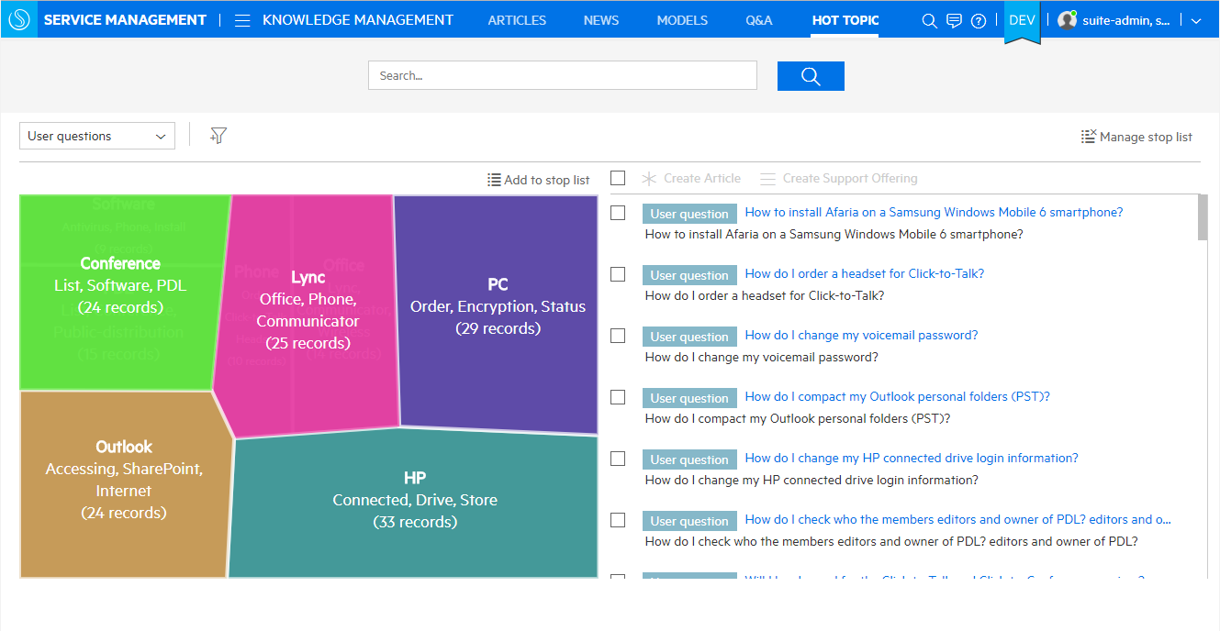
Machine Learning and Analytics Based Service Desk
Hot topic analytics
Search for hot topics
Configure stop word lists
Create
knowledge articles
catalog offerings
problem records
Shows analysis of important interest areas
Displays hot topics and record counts
Notes:
NOTE: Screenshot shows SMAX

Slide 9
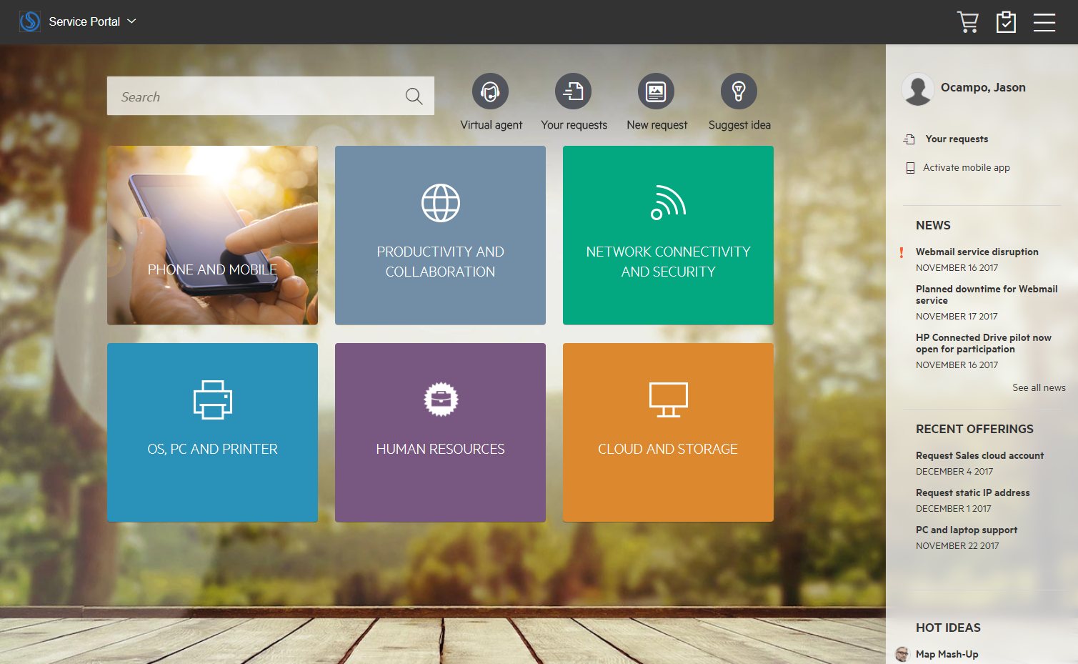
Smart Self-service With Social Collaboration
An engaging user experience, via the web and mobile
Shopping cart
IDOL based search
Suggest idea
Native mobile app
Personalized
News alerts on active outages.
Catalog offerings

Slide 10
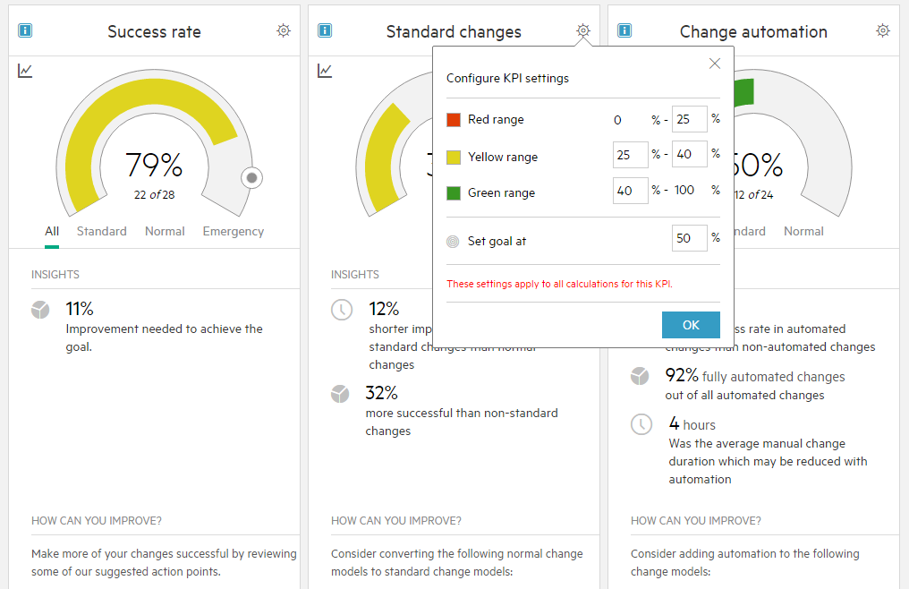
Modern User Experience for Enterprise Applications
Smart change analytics
Big data predictive analytics change owners to make process improvements
Analytics identify areas that can benefit from standard modeling and automation as means to reduce risk, increase success rates, and reduce implementation times
Insights
Recommended improvements
Notes:
NOTE: Screenshot shows SMAX

Slide 11
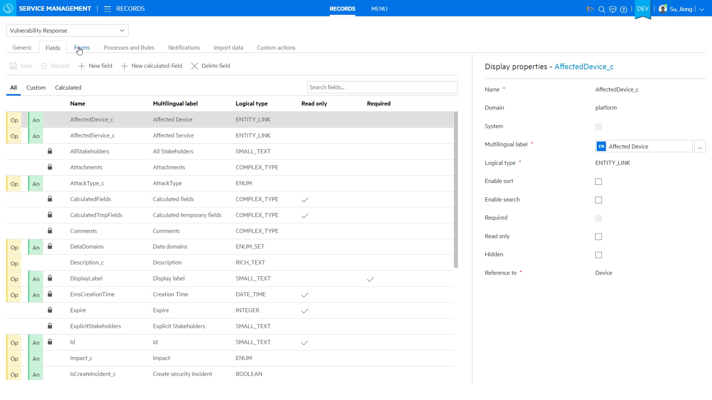
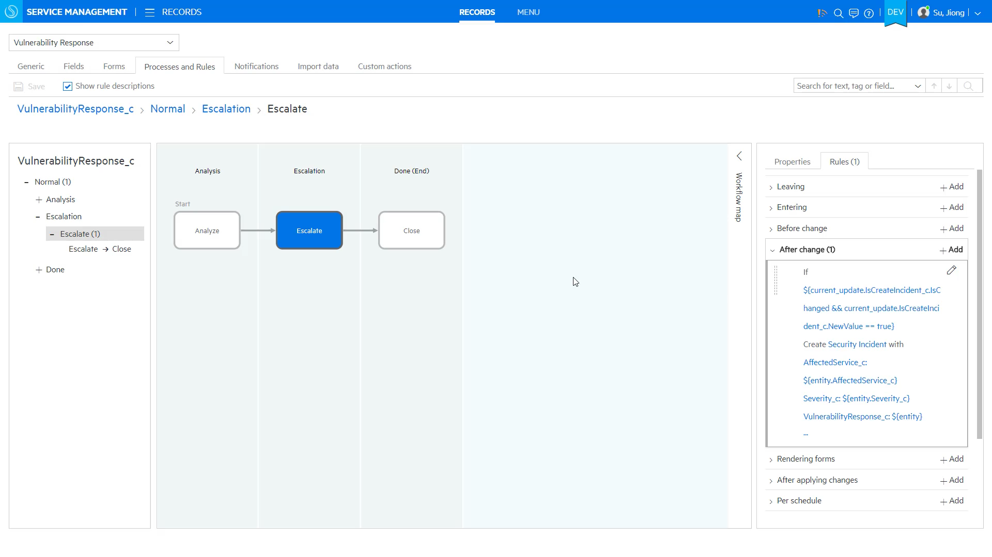
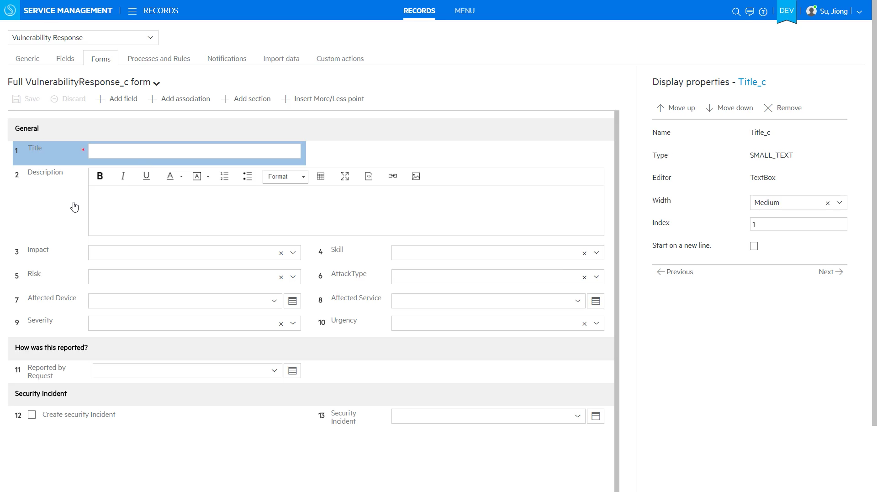
Codeless Configuration and Easy Upgrades
Instant creation of new service management applications
New process based application
Create app workflow
User defined table
Create form for new app
Notes:
NOTE: Screenshot shows SMAX

Slide 12
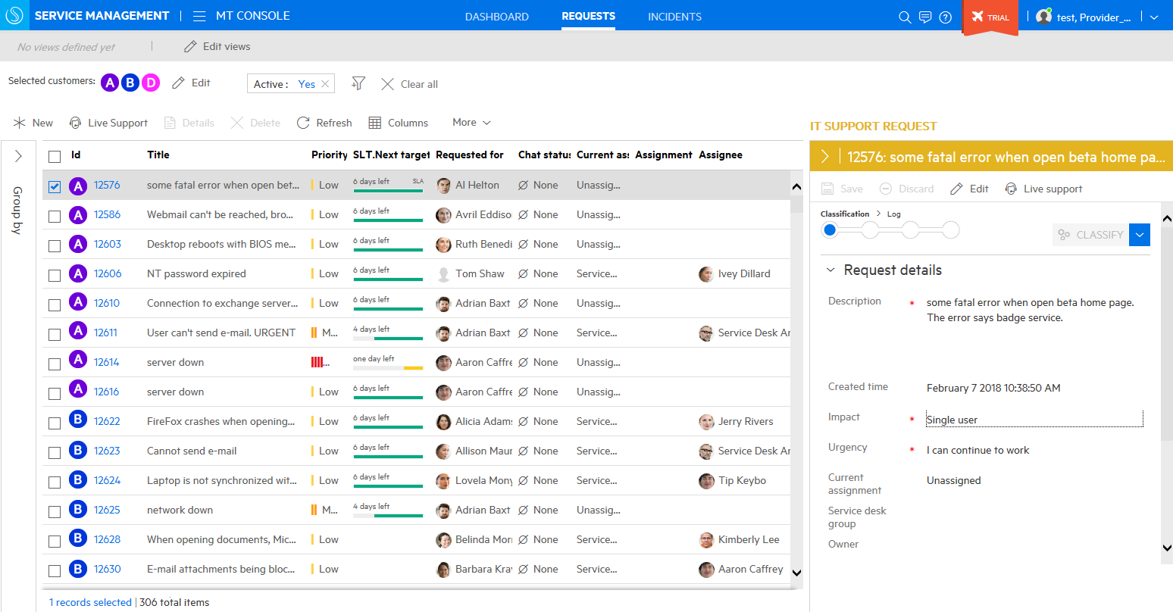
Multi-tenancy for Service Provider Support
Work with multiple tenants from a single console
Multiple customers in a single console
Request details with impact, urgency etc.
Customer A
Service level targets and priority indicate importance and urgency
Customer B
Notes:
NOTE: Screenshot shows SMAX

Slide 13
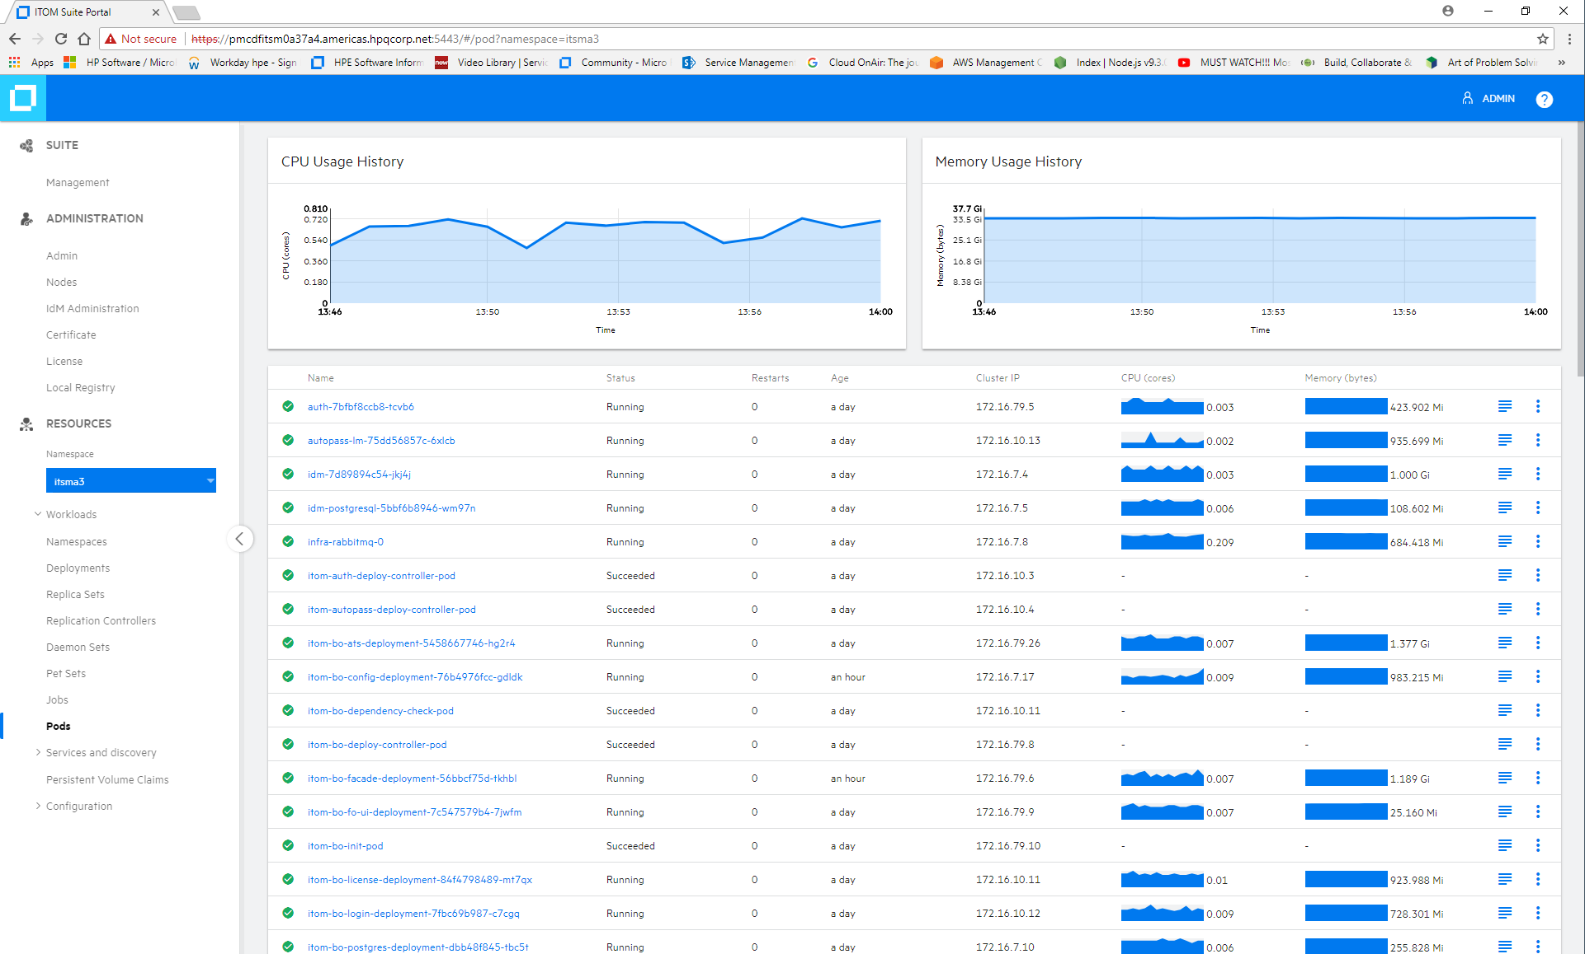
ITOM Platform With Deployment Choice
Quick time to value while minimizing implementation and update effort
Quick installation with pre-integrated containers
Modern UX, REST APIs, Bots
Operations
Orchestration
Configuration
Management and Discovery
Collect Once Store Once
(with Vertica)
Business Value
Dashboards
(Reporting)
ChatOps
Micro Focus Services
(CI/CD, Admin, Login, License)
Ecosystem
Services
(Partner, Third Party, Community)
Update and patch with zero downtime
Container Deployment Foundation
Auto-scaling, self-healing and secure
PHYSICAL
VIRTUAL
CLOUD
CONTAINER
Deployment choice
New functionality available with each quarterly release
Notes:
We believe that a broader view of IT Ops is required. A blending of DevOps and AIOps. And this requires a platform.
Our ITOM Platform is here today. Products don’t sit on top --- They are built into this platform
Providing a modern UX per domain -- Bots -- API’s -- Extensible -- Extend the platform - our partners are already doing this. --- Deploy anywhere
This is the first and only modern IT Ops platform in the industry -- Really unique here -- Integration and Installation times in just a few hours, Updates in a few minutes, Scaling in seconds
Each product suite becomes a set of microservices selected from the overall ITOM Platform.
Built on our Container Deployment Foundation – modular, flexible, scalable
The Container Deployment Foundation touches on 4 areas
Distribution. All of the suites come now with a standard licensing model. Instead of multiple license model we boiled down to one easily manageable license unit. They come up and are all delivered in pre-integrated containers. OOTB, inside the factory we are doing a lot of pre-integration for standard use cases.
Install and update. Suites built with the Container Deployment Foundation are very easy to install. very easy to maintain, with automated updates, and automated patching. And very soon, over the next couple of quarters we will get to the point when we actually expend the capabilities to have a zero downtime, asynchronous updates.
Auto-scaling. Suite deployments can flex in and flex out, so patches, rollbacks, getting bigger, getting smaller, - it will all just happen. And it happens at scale. It will happen within seconds, to expand the footprint of the product, reduce the footprint of the product, very quickly and very easily.
Deploy Anywhere: It is available to be deployed on-premise, in public cloud, in private cloud or on containers. So eventually you will be able to have on-prem, off-prem, in AWS or Azure. MSPs will be able to offer it, it makes it extraordinarily portable.
All of this done on top of an automated and modern orchestration layer built natively to handle container clusters at scale. The Container Deployment Foundation delivers a state-of-the-art container management and orchestration framework leveraging the Docker container architecture and Kubernetes for orchestration. Both CLI and API management is offered as well.
Core services: integrate across IT Ops – to a new level
Operations Orchestration – THE industry standard- 8000+ item content library , HTML5 UI, import content
CMS 11- best large scale UD & UCMDB- HTML5 – Search – Cloud & Containers
ChatOPs – First- security – now including support for MSFT Teams
Collect Once, Store Once (COSO) architecture – Broadest coverage
Business Value Dashboards

Slide 14
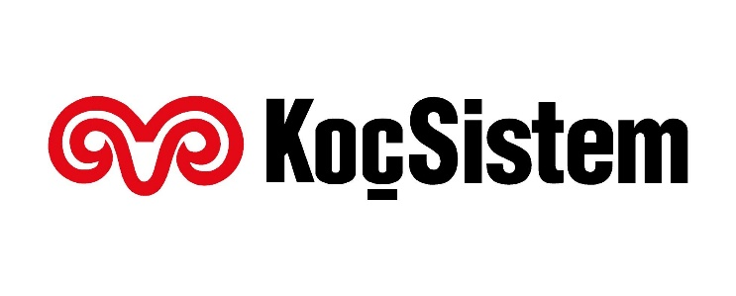


Delivering Customer Outcomes
Ticket self-management delivers a 26% reduction in incidents
Better allocation of help desk resources
$500,000 savings in asset consolidation
50% first year ROI recovery
Increased change success rate to 99%
Achieved 85% first call resolution
Notes:
NOTE: these are all SMA – Service Manager customers
Sources:
- 4AA6-2674EEW.pdf (KocSistem)
- 4AA6-5403ENW.pdf (BCCSS)
- 4AA5-8967ENW.pdf (Valero)

Slide 15
Software Services for Hybrid IT
Guiding customers through their transformation journey
Enterprise Support
24x7
Follow the Sun and prioritized support
Online Support
Read More
FlexCare Support
Personalized advanced support
Credits for key stage of your journey, such as upgrading to new versions
Read More
Professional Services
Transformation workshops
Maturity assessment and roadmap
Implementation
Solution management
Visit Here
Software Support Online
Average wait time <30sec
Average solve rate 70%
Visit Here
Software Community
Expert Days
Support tips
Customer webinars
Staffed 24x5
Visit Here
Notes:
In our always-on economy, businesses run 24 hours a day. This is why your staff need fast, 24-hour access to our Software Support experts who can diagnose and resolve issues as well as give advice on HPE Software product features.
Enterprise Support (24x7 Support) is our standard offering and a prerequisite to HPE FlexCare Support. It provides you with fast 24-hour access to HPE Software experts who can diagnose and resolve your issues, who have the knowledge to increase uptime, reduce total cost of ownership, and drive efficient business outcomes.
FlexCare Support can provide a wide range of personalized reactive or proactive support related assistance - such as support on deployment, product education, health check and supportability review, new feature usage and configuration or troubleshooting mentoring.
Professional Services with strategic consulting, implementation, support and education services help you realize the most value from your Micro Focus Software investment.
With Software Support Online (Chat) you can directly talk to Software Support
The Software Community provides expert days, support tips, blog articles etc.

Slide 16
Service Management Automation X
SMAX
Edition | SMAX Express | SMAX Premium
Edition use case | Service Management | Service Management, Asset Management and ESM
Features | Service Desk and Service Portal Native mobile app Smart analytics Studio ChatOps Service Portfolio Management Service Catalog Management Service Level, Change, Release, Knowledge, Incident, and Problem Management SACM Universal CMDB Vendor Management | SMAX Express + Catalog Aggregation Contract Management Procurement Management Software Asset Management Financial Management Idea & Proposal Management Application Portfolio Management Project & Program Management
Delivery format | CDF
Deployment Options | On-premise, Aws, Azure
OS & database support | Support Matrix

Slide 17
Service Management Automation SM
SMA-SM
Edition | SMA-SM Express | SMA-SM Premium
Edition use case | Service Management | Service Management, Asset Management and ESM
Features | Service Desk and Service Portal Native mobile app Smart analytics Process Designer ChatOps Service Portfolio Management Service Catalog Management Service Level, Change, Release, Knowledge, Incident, Problem Management SACM Universal CMDB | SMA Express + Vendor Management Contract Management Procurement Management Software Asset Management Financial Management
Delivery format | “Classic”
Deployment Options | On-premise
OS and database support | Support Matrix

Slide 18
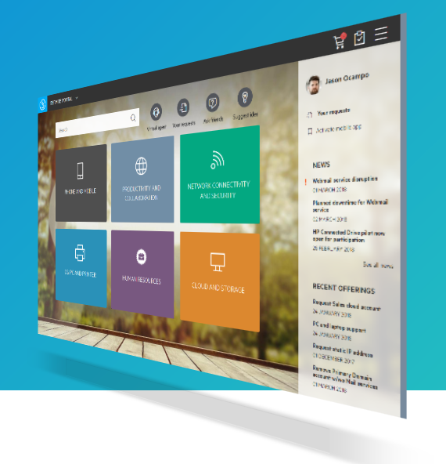
The Service Management Automation Advantage
Satisfied business users and efficient IT staff
Machine learning and analytics for low ticket volume and fast resolution time
Smart self-service and social collaboration for increased end-user autonomy and satisfaction
Modern user experience for enterprise applications at high service quality
Codeless configuration and easy upgrades for a low total cost of ownership
Multi-tenancy and flexible deployment options for IT and LOB service management initiatives
Single ITOM platform for quick time-to-value and continuous delivery
Notes:
[This is a summary of the key differentiators discussed before]

Slide 19
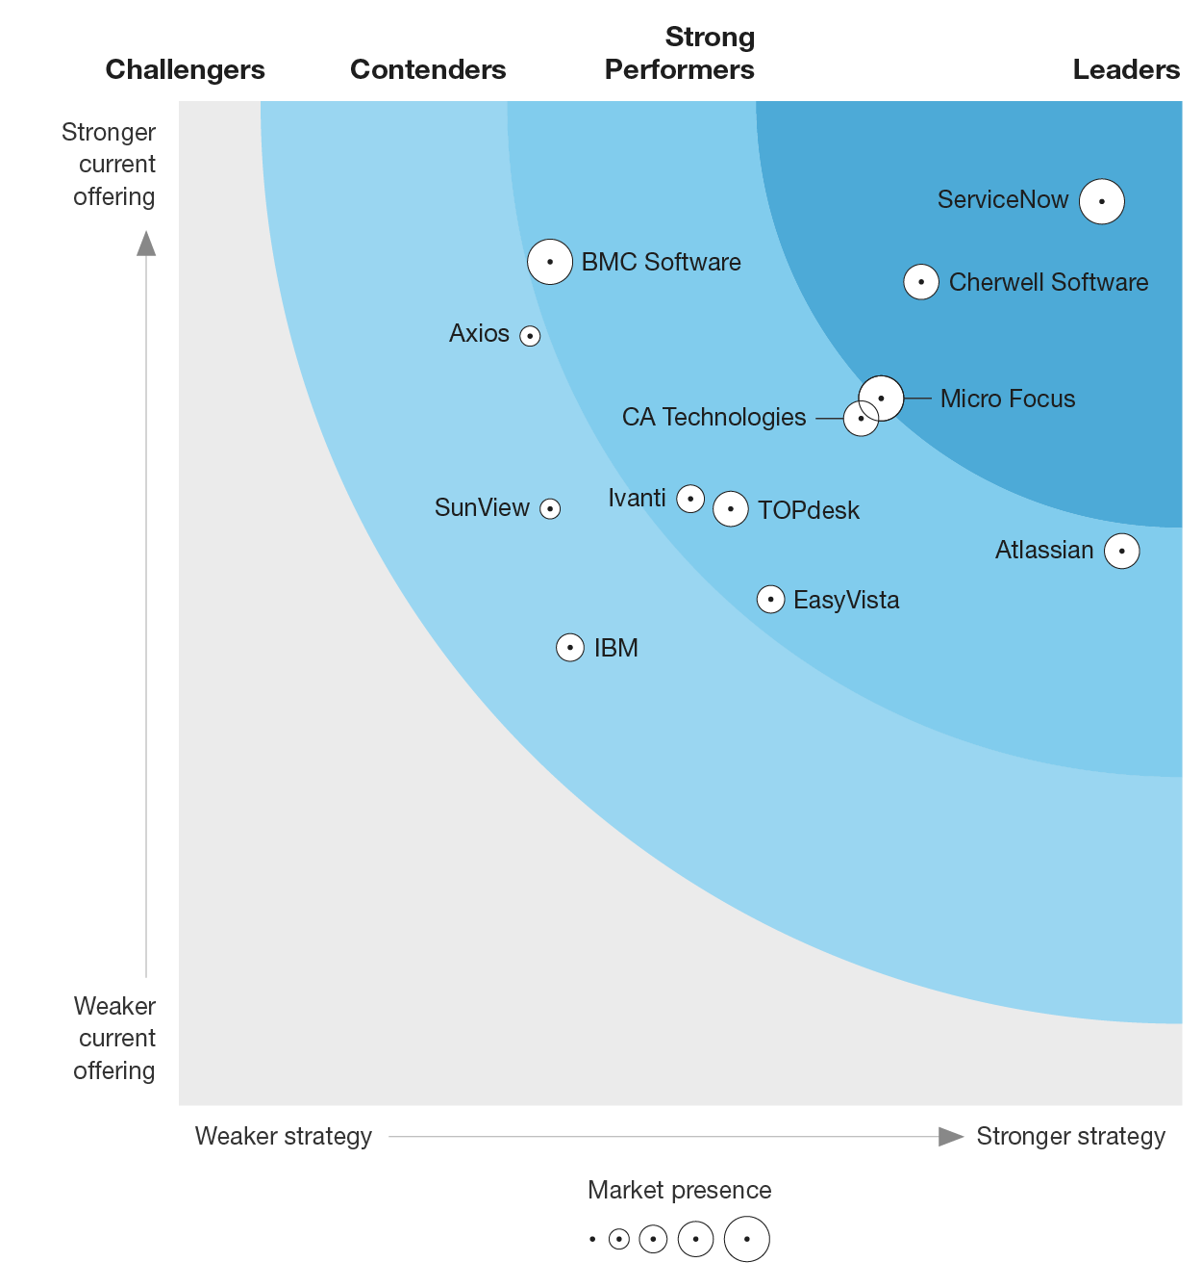
Forrester ESM Wave – 2018
Read the report at: www.microfocus.com/itsm

Slide 20
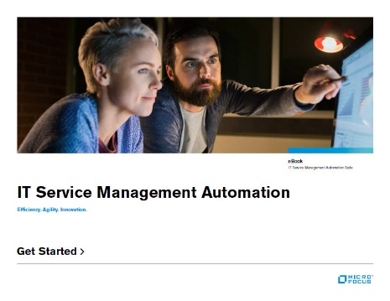
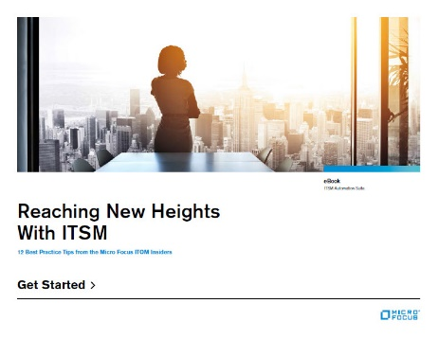
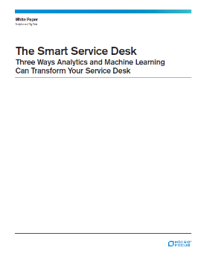
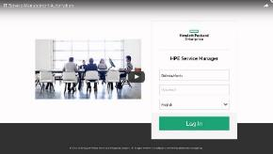
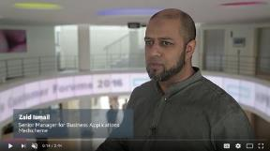
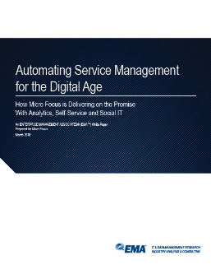
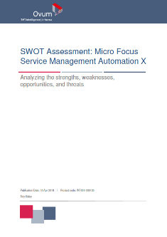
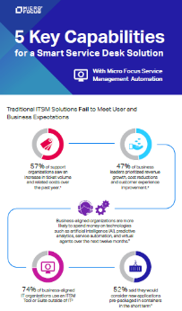
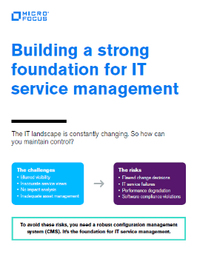
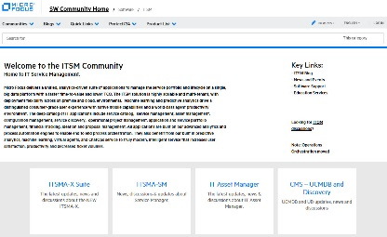
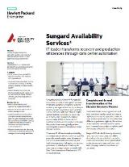
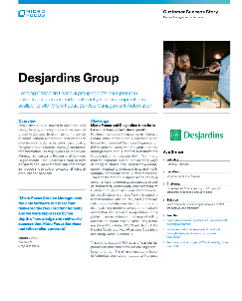
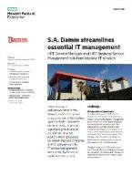
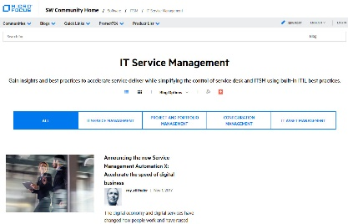
Getting Engaged
Brochures, data sheets
eBooks
Videos
Whitepapers
www.microfocus.com/itsm
Analyst reports
Infographics
SMA community
Customer stories

Slide 21
Thank You

Slide 22
Backup SMAX

Slide 23
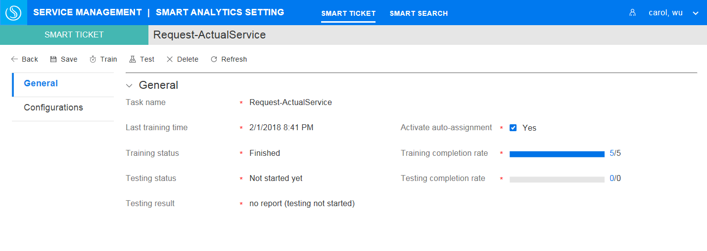
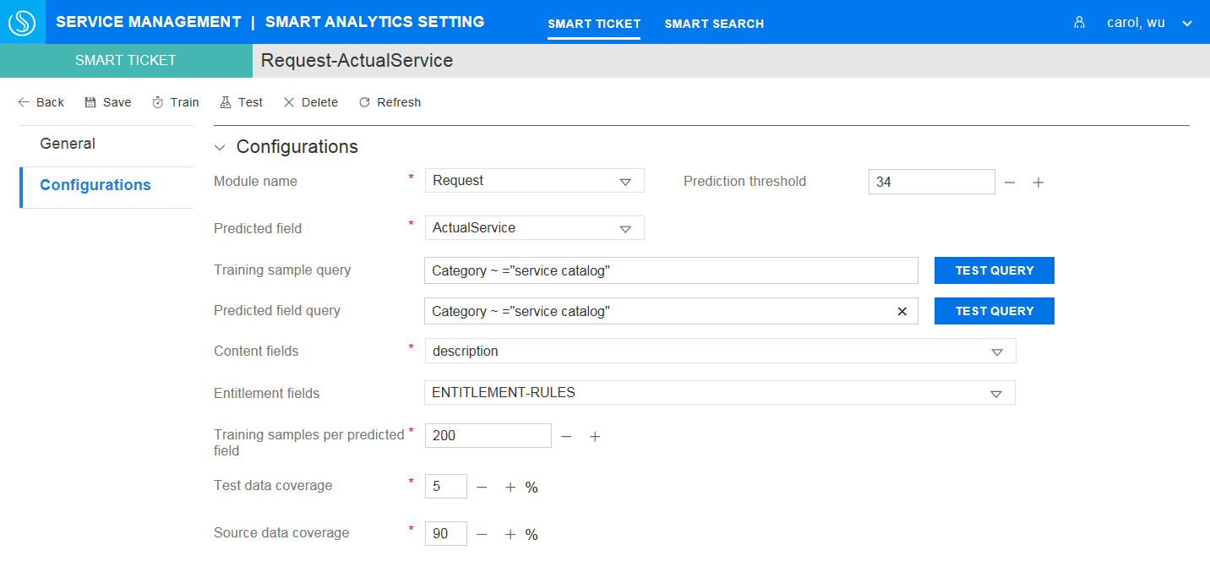
Smart ticketing and machine learning
Automatically accept and route service requests

Slide 24
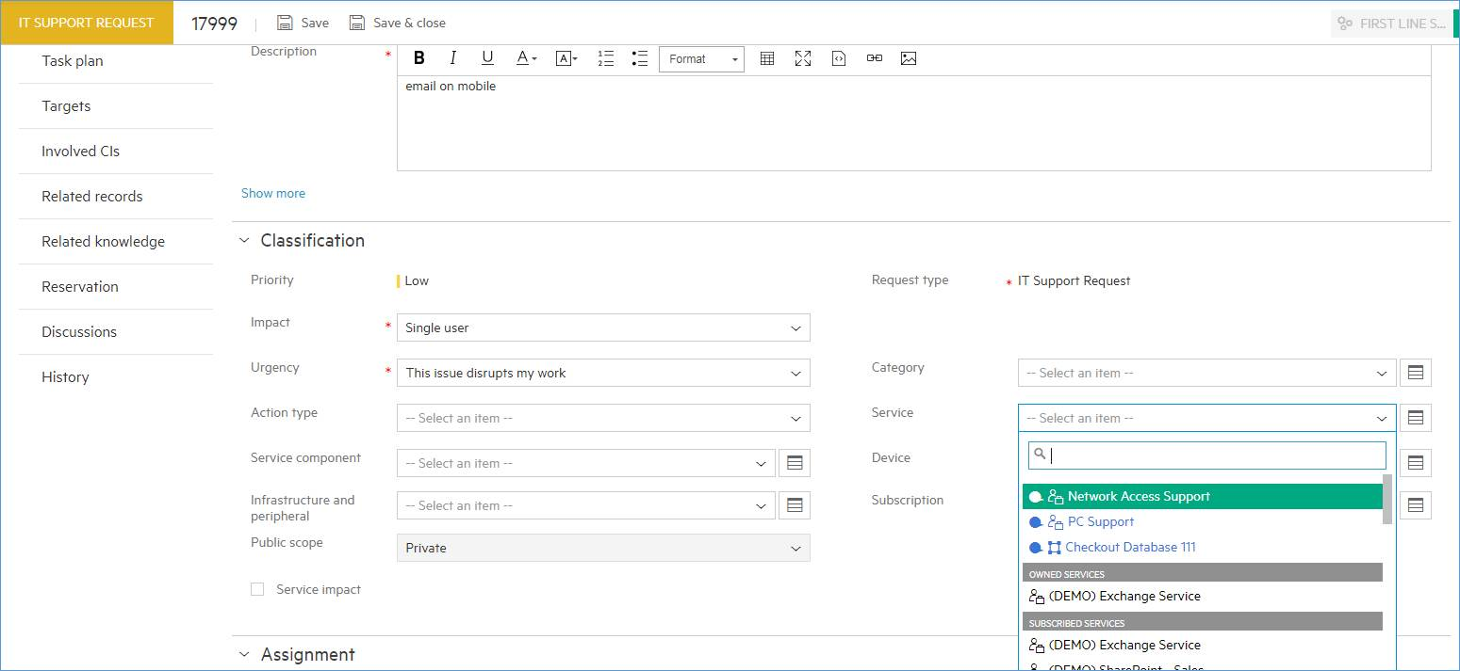
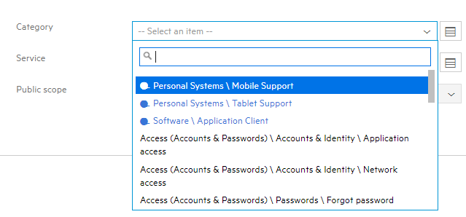
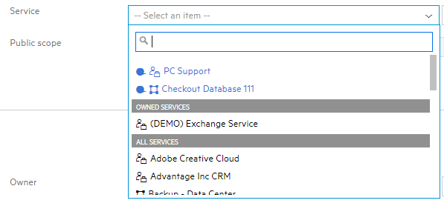
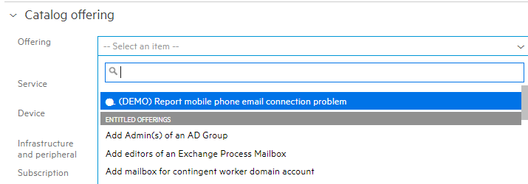
Smart suggestions for Category, Service and Offering
Shown at the top and in blue in the drop-down list

Slide 25
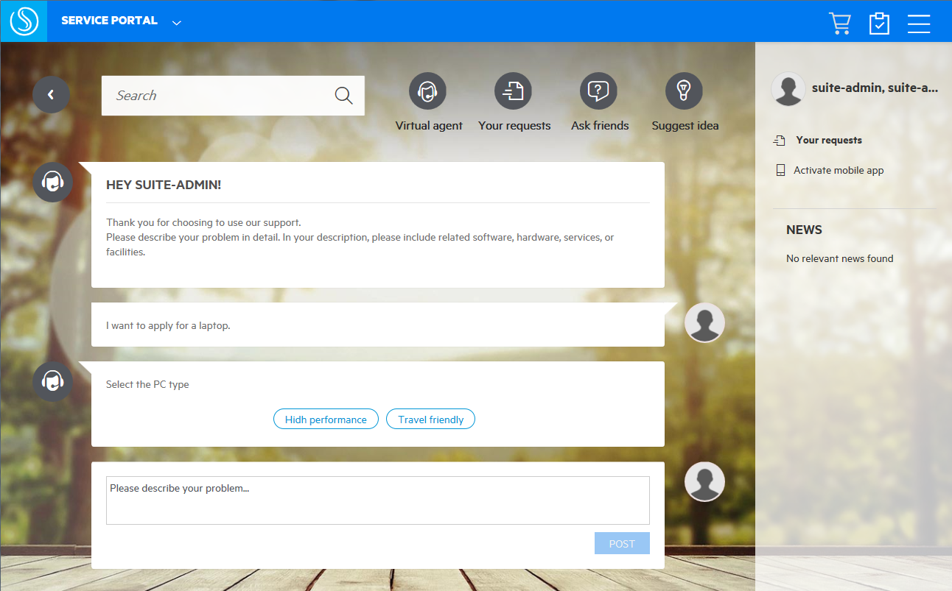
Virtual agent
Automated assistance with integrated live-chat

Slide 26
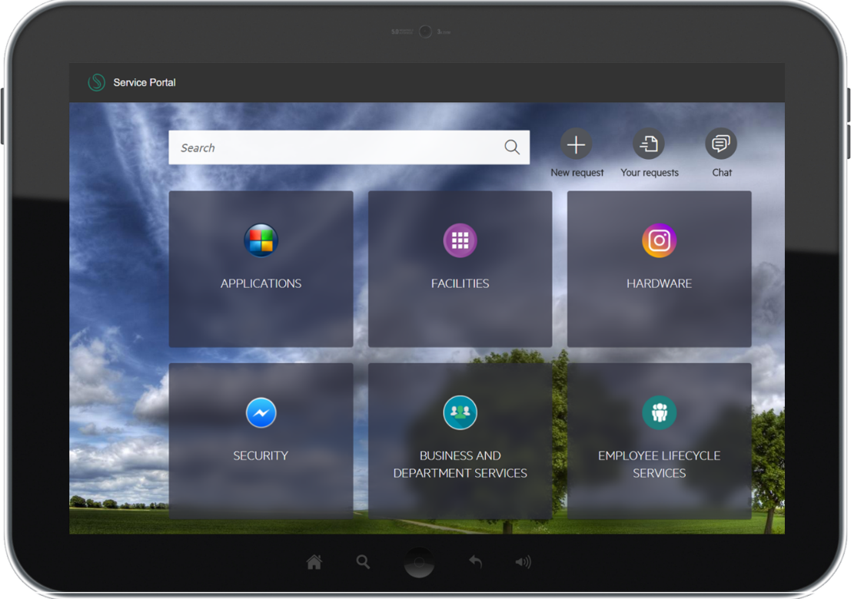
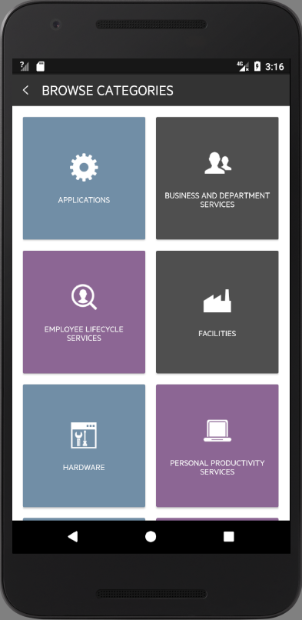
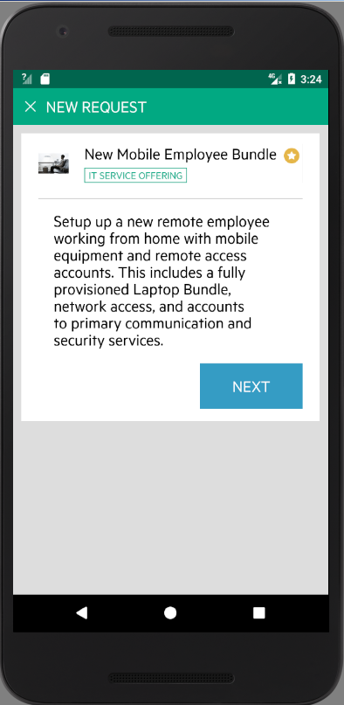
Native mobile apps
For end users
Android
iOS

Slide 27
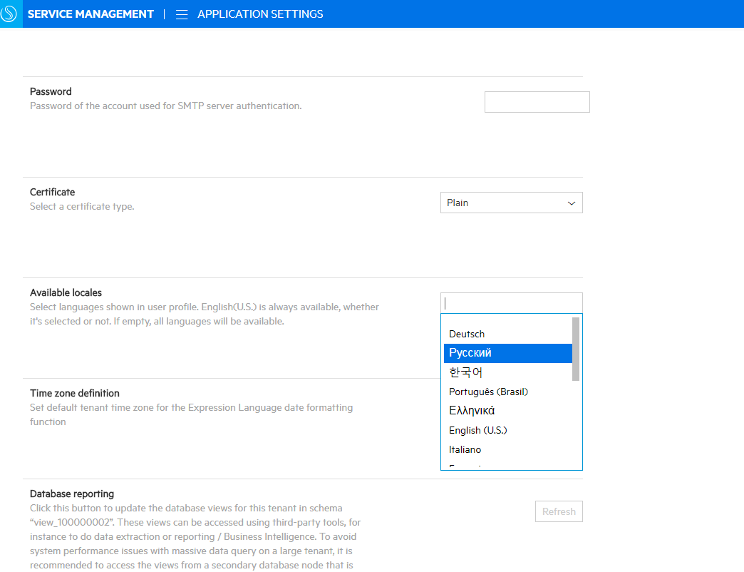
On-the-fly translation
A new application setting: Available locales
User can either add new available languages, or replace the translation of current supported language

Slide 28
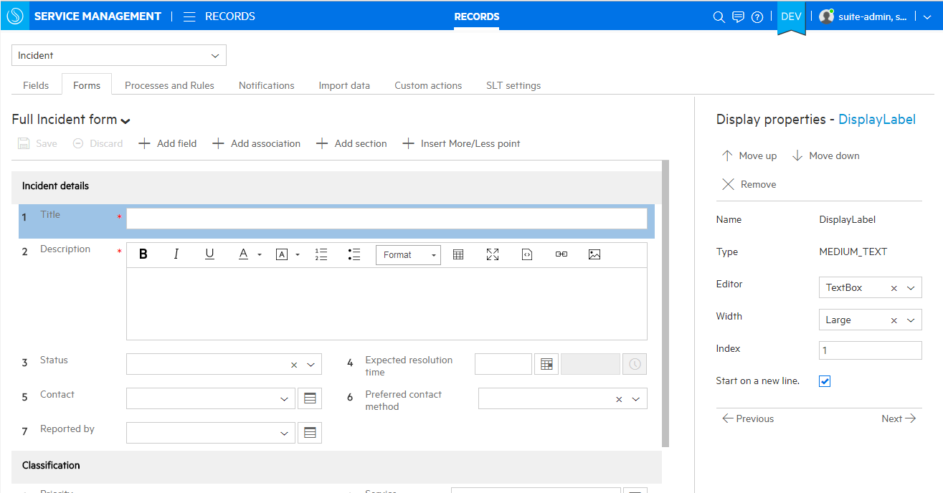
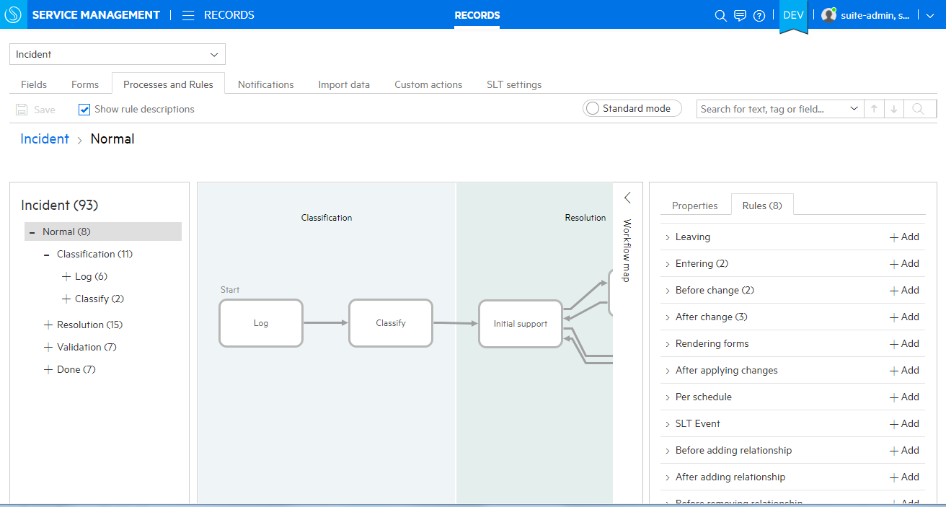
Codeless Configuration
Create, configure and maintain processes and workflows easily
WYSIWYG forms editing
No programming knowledge required
Retains custom configurations for seamless updates
Simple graphical interface
Notes:
NOTE: Screenshot shows SMAX

Slide 29
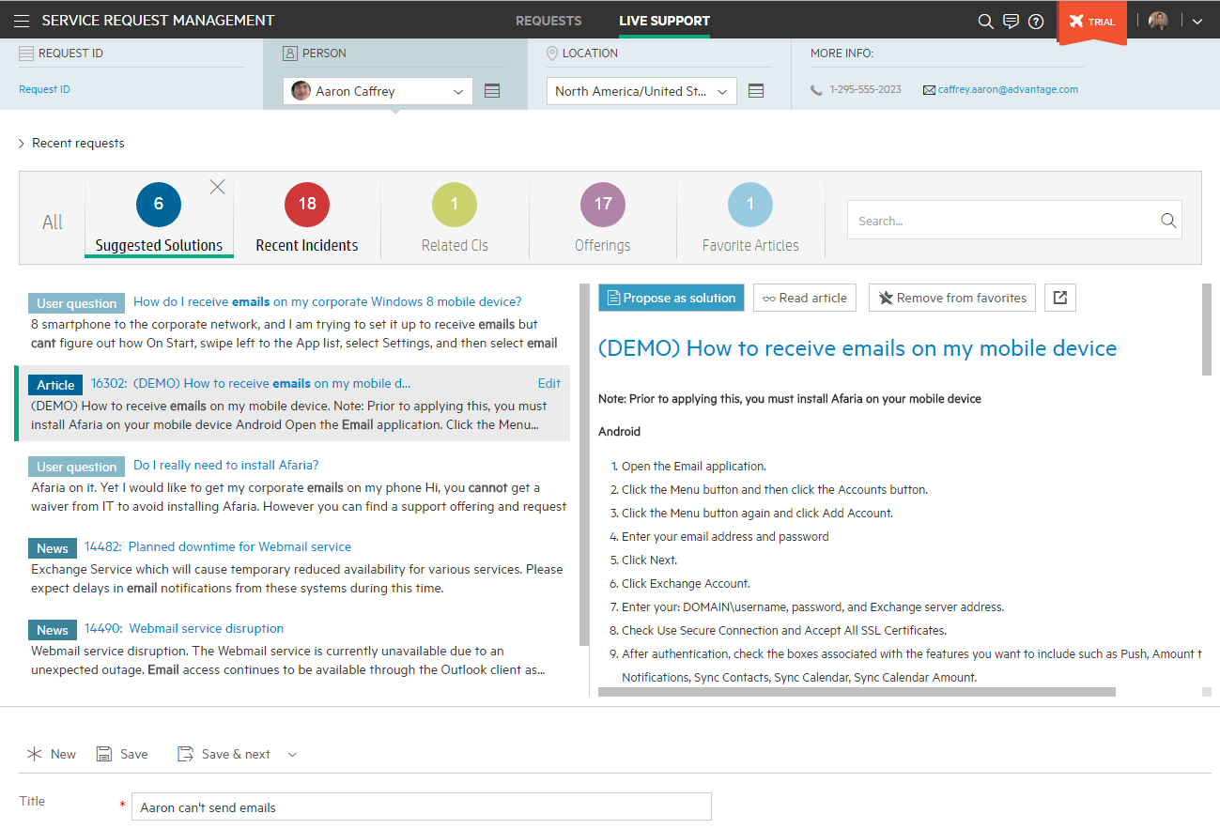
Proactive Live support
Caller details – including their recently opened requests
Optimized experience for live phone based support. Minimize clicks and maximize productivity.
Proactive suggestions found through big data search of solutions, knowledge, related tickets, and assets

Slide 30
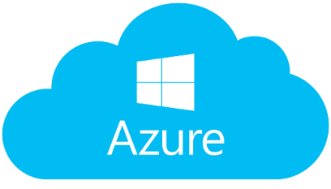

Public Cloud Support
Azure production support and AWS enhancements
Public cloud support
Azure production support with native Azure services and automated deployment (SMAX)
SMAX deployment with Medium Profile – up to 500 concurrent agents – on Azure supported
Currently, for production, NetApp ONTAP Cloud for Azure must be used as a storage solution to meet performance requirements
Improved SMAX deployment on AWS with multiple availability zone (AZ) support

Slide 31

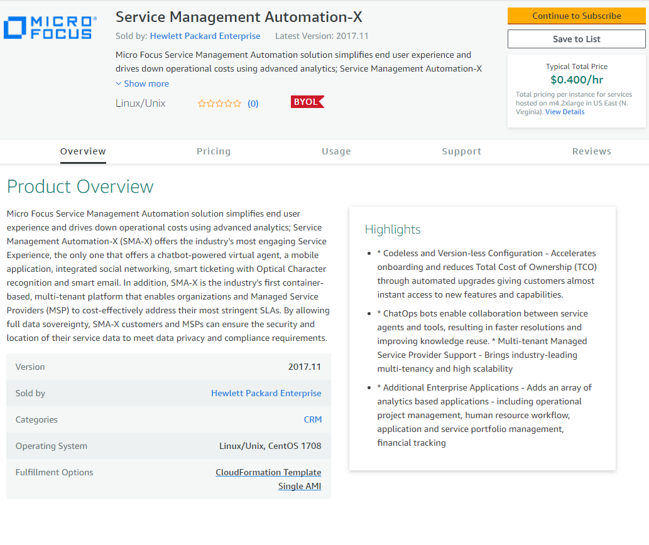
Availability on the AWS Markeplace
Built for
What:
SMAX on CDF delivered in the AWS marketplace
Offered as Amazon Machine Images (AMIs) which allows the customers to deploy and run the software under their own AWS account on AWS infrastructure.
Currently the pricing model is BYOL (Bring Your Own License)
Benefits:
Single click SMAX deployment on AWS
Easy deployment and consumption of SMA, while the customer controls the data
Great demo and POC experience – available in any AWS region
SM customers and prospects can explore additional use cases (e.g. LOB service desk) quickly and cost effectively
SMAX is approved by AWS Professional Services (ProServe) consultants that the software is designed reliable, secure, efficient cost-effective for the cloud.

Slide 32
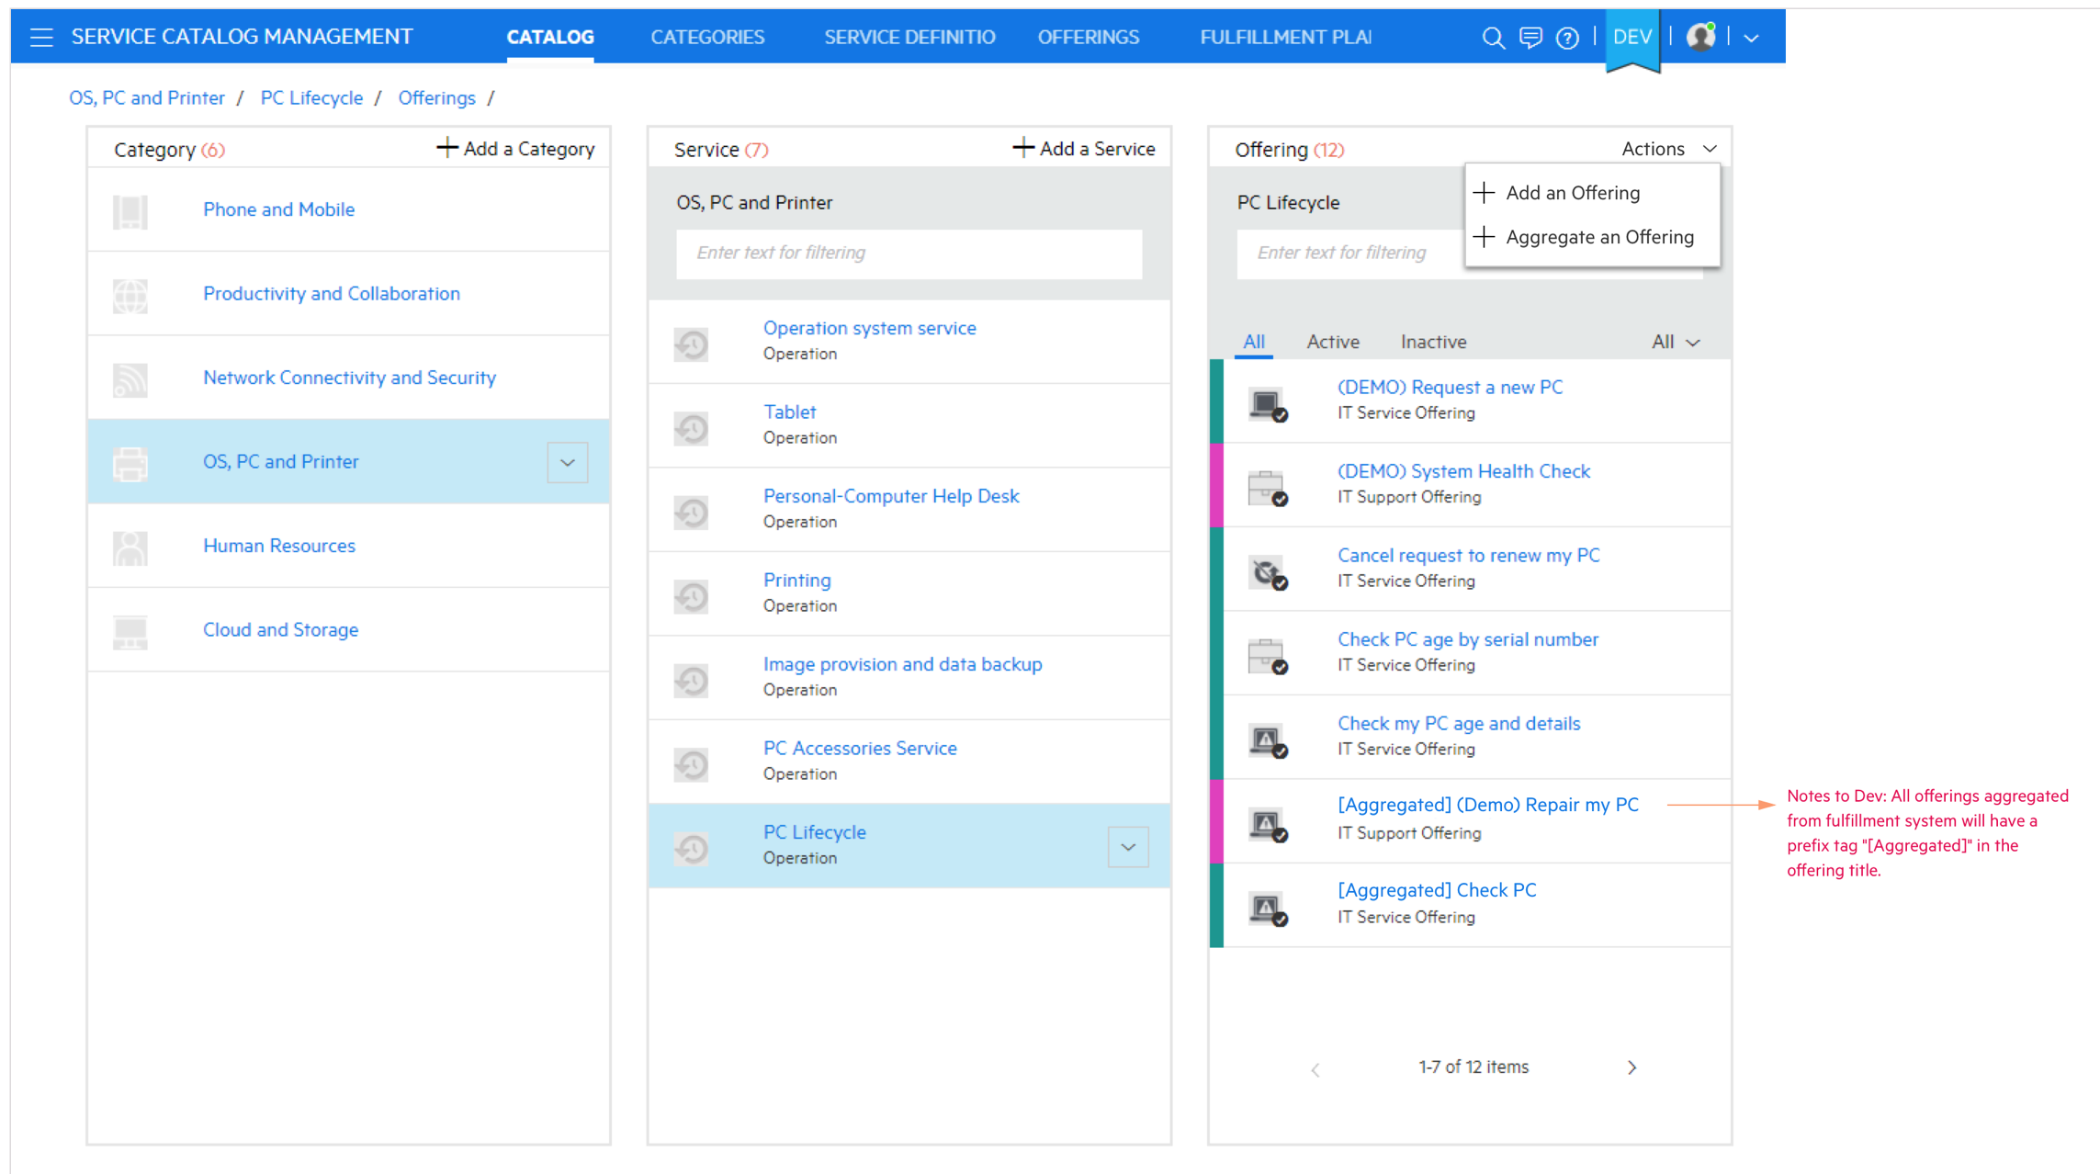
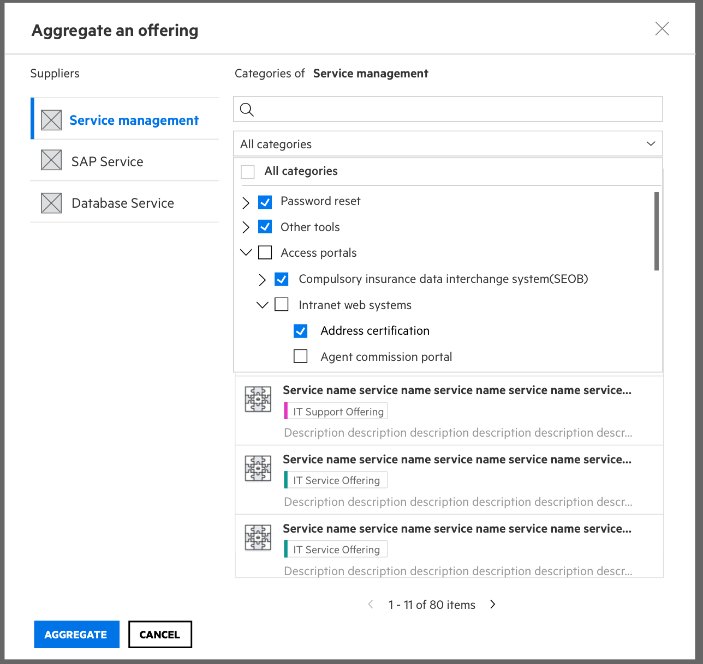
Catalog Aggregation in SMAX (beta) Single portal experience
Allows an administrator to aggregate catalog offerings from external fulfillment systems into the SMAX Service Portal, providing a unified point for requesting, tracking and monitoring
End users can request aggregated offerings from the catalog, and track status of requests
The solution supports:
Adding a new backend supplier for aggregation
Creating bundles in X based on aggregated offerings
Tracking requests as an end user
Aggregation of Service Manager catalog supported in 2018.05 release
Additional adapters and SDK are planned for later as part of roadmap.
Aggregation will be in SMAX Premium
Popup to display aggregate offering menu
t

Slide 33
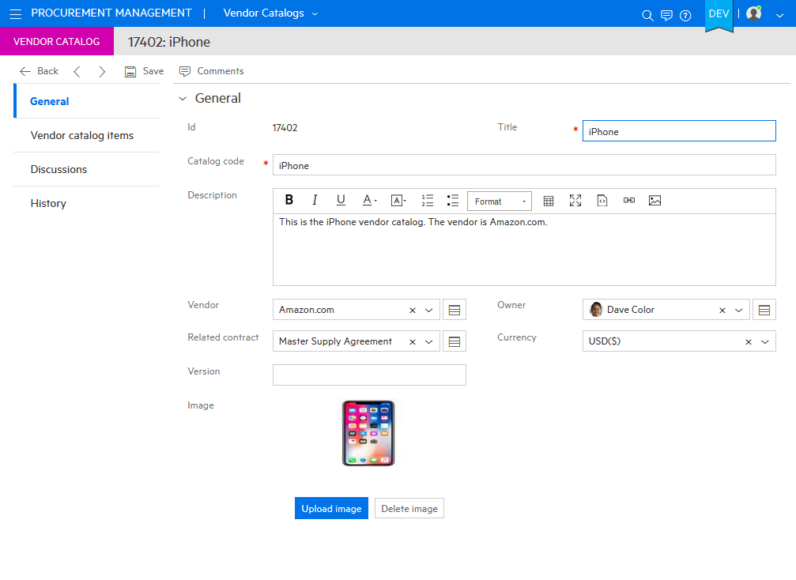
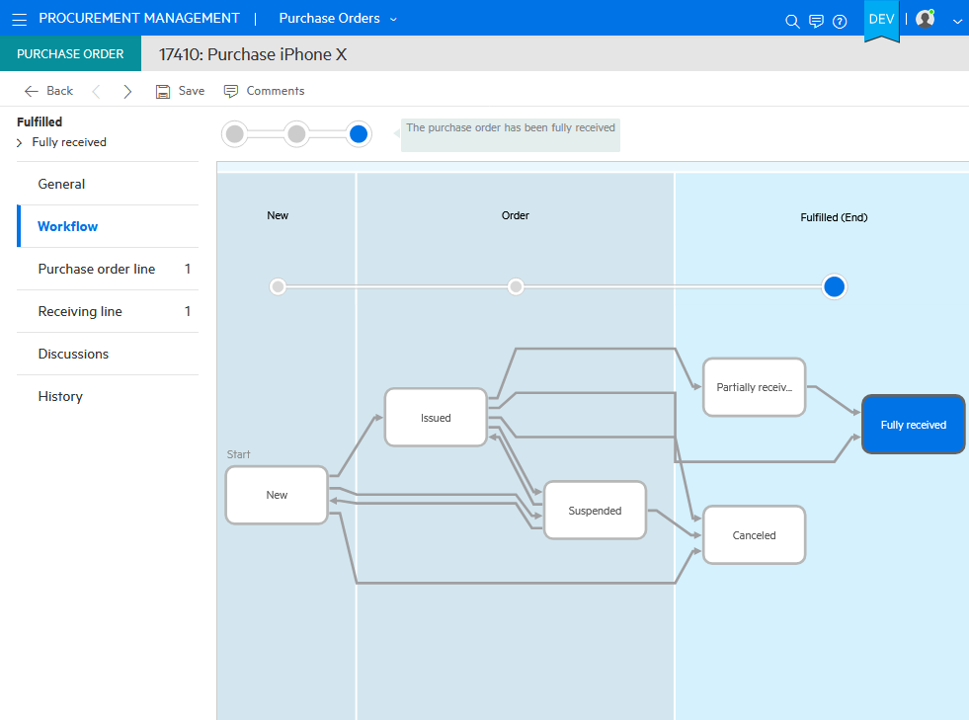
ITAM Procurement Module in SMAX (Premium)
Manage and track purchasing information
Create and manage vendor catalog and catalog items
Manage POs and PO lines, receive assets and move into stock
Notes:
Introduction of a new Procurement module for tracking and managing purchasing information.
Procurement module manages the end-to-end lifecycle of IT asset purchases. It tracks and manages purchase orders and purchase order lines, as well as the relationship with purchase requests. It facilitates moving purchasing assets into stock and reconciles with inventoried assets.
It creates a product catalog and supplier catalog, and defines the mapping between each other

Slide 34
Backup SMA – Service Manager

Slide 35
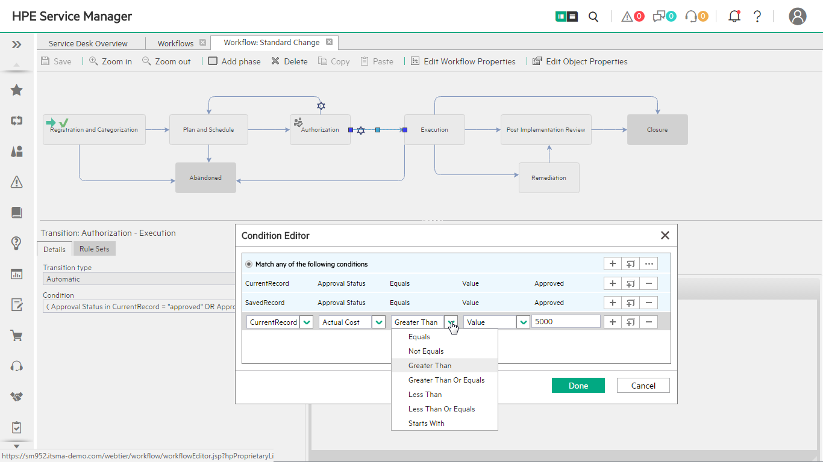
Codeless Configuration
Process designer (SMA-SM)
Drag and drop to create and modify workflows
Easily define details per workflow phase
Easy to define workflow logic
Notes:
Process Designer provides simple and efficient customization with codeless configuration. It comes with instant processes and workflows based on ITIL® best practices, which are easy to customize, to configure and to update.
The results: Quick time to value, low total cost of ownership (TCO), and low update and migration costs.
Key characteristics and capabilities of Process Designer include:
Out-of-the-box processes, 100 percent ITIL aligned
Separates system code from user configuration
Single, intuitive and easy to use graphical user interface
Easy to define and maintain workflow and business logic
Based on ITIL and Service Management Reference Model
Support all key processes, including incident and problem management, knowledge management, change management, request fulfillment, and service level management

Slide 36
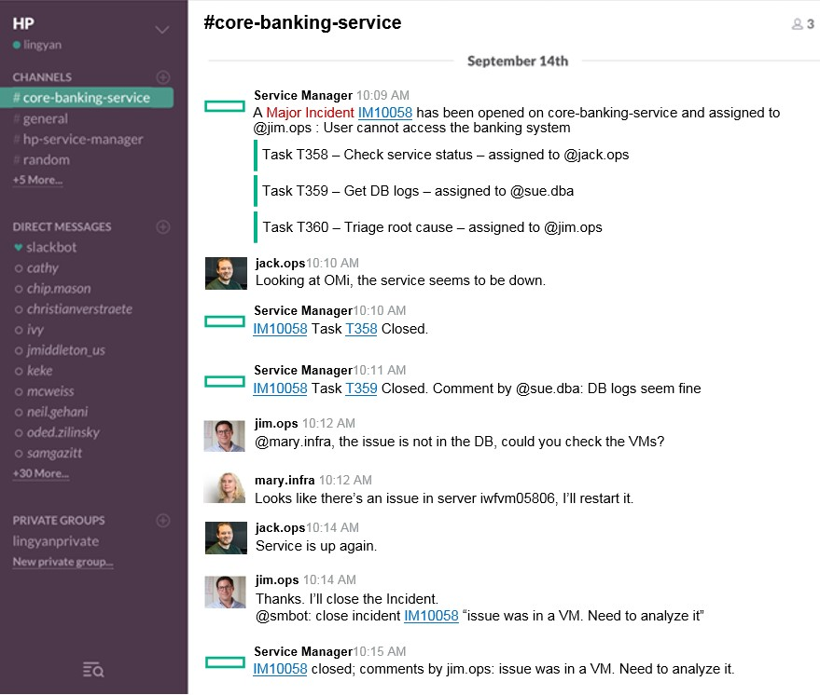
Collaboration
ChatOps
Virtual war rooms
Chat robots are part of the collaboration
Chat flow
Multiple people can collaborate to solve an issue
Notes:
ChatOps is one of the leading innovations in SMA. It provides a virtual war room to efficiently improve IT agent collaboration.
ChatOps helps to solve issues faster in an efficient transparent way using real-time chat
- Assemble the right people, right tools & data at right time
- Cross-boundary collaboration of people, process, tools and automation
- Resolve once, re-use next time … automatically document entire incident resolutions in a transparent, repeatable fashion

Slide 37
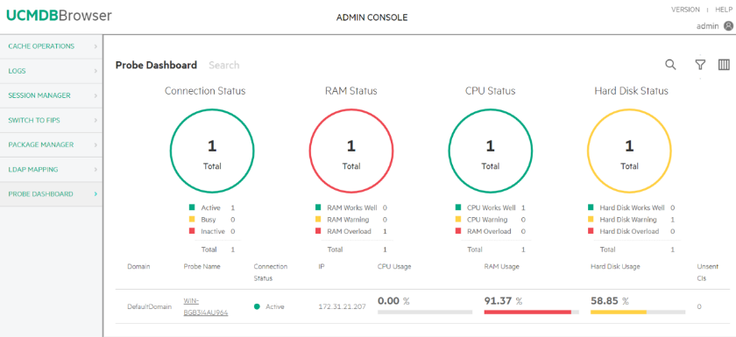

Configuration Management System (CMS)
Industry’s best combination of bottom up and top down discovery and modeling
Intuitive web browser interface Easy access to all CMS data
Single tool Federated CMDB, discovery, inventory and dependency mapping
Automated Discovery Cloud and on premise Top-down and bottoms-up Agent-based, agent-less, hybrid, and passive
Automated service modeling Easy, fast dependency modeling to a top-down model of a business service
Common platform integration across ITOM tools
Notes:
The Configuration Management System (CMS) is a comprehensive set of tools for collecting, storing, managing, updating and presenting data about IT services configuration items (software and infrastructure) and about their relationships.
CMS includes Automated Discovery (Micro Focus Universal Discovery) and a federated configuration management database (Micro Focus Universal CMDB) that integrates with trusted sources in a seamless fashion-allowing IT management teams to make effective decisions and control changes.
Key capabilities include:
- Agile top-down and bottoms-up discovery - agent-based, agent-less, hybrid, and passive
- Automated service modeling for easy, fast dependency modeling to a top-down model of a business service
- Cloud and on premise discovery capabilities
- Both inventory and dependency mapping in a single tool
- Easy access to all CMS data via intuitive web browser interface
- Common platform integration across all ITSM and Operations Analytics tools

Slide 38



IT Asset Management
Maximize the value of your IT investments
Service Asset Configuration Management Records, tracks and controls costs associated with delivering IT services
IT Asset Portfolio Management For a consistent and accurate picture of relationships between assets, contracts, and costs
Consolidate and streamline procurement Automates and streamlines the entire request lifecycle
Financial Management and Chargeback For budget planning, cost recovery, visibility into business services
Software Asset Management (SAM) Ensures software license compliance
Notes:
Asset Management automates best practices across the asset management lifecycle and integrates processes into IT Infrastructure Library (ITIL) service support workflows including incident, problem, and change management to improve service quality and business outcomes.
Service Asset Configuration Management enables the IT organization to link activities and investments of ITAM and configuration management. It records and tracks costs associated with delivering IT services and maintains an accurate picture of the organization’s IT infrastructure used throughout the ITSM processes.
IT Asset Portfolio Management tracks, defines, and manages relationships between assets, contracts, and costs. It provides consistent and accurate inventory information. Asset tracking processes are simplified by consolidating assets and each configuration item into a central repository.
Consolidate and streamline procurement processes automates and streamlines the entire request lifecycle. It verifies each request against corporate approval standards by checking against a catalog of approved assets.
Financial Management makes tracks costs associated with every asset at every stage in its lifecycle, including expenses related to capital and operations. The ability to chargeback for the utilization of virtual or physical assets enables cost recovery and provides visibility into the business services being consumed at the business unit level budget planning.
Software Asset Management (SAM) is becoming an increasingly important requirement for enterprises as software license audits become increasingly costly and common among major software vendors. SAM helps ensure software license compliance, reduces operating costs and optimize license spending.

Slide 39
Cloud Management Journey to Value
Optimized
Service Aligned
Stage 5
Stage 4
Broker fully compliant IT services
Continuous delivery with continuous compliance
Aggregate catalogs to build and operate hybrid services for cloud brokering
Managed
Applied
Stage 3
Service-level IT compliance audit and remediation
Discover existing services
Application release automation and continuous delivery
IT self service consumption
Aware
Stage 2
Application release automation and continuous delivery
IT self service consumption
Analytics and reporting for showback and usage
XaaS: Anything as a service – infrastructure, platform, DB and MW
Stage 1
IT self service consumption
Analytics and reporting for showback and usage
IaaS, DBaaS and PaaS: Design, provision and configure DB, MW and other hybrid cloud platforms with OOTB content
IT self service consumption
Analytics and reporting for showback and usage
IaaS: Design, provision and configure hybrid cloud infrastructure
Capacity optimization
Automate runbook
Value journey

Slide 40


Customer story: Service Management Automation Enables Faster Time-to-market
Challenge
Result
A constant increase in the number of incidents (6 MIO/Y) and changes (600 K/Y) resulting in inability to meet the business demand
Upgrade downtime reduced from 16h to 2h
Significantly faster development of new functionality with process designer
Smart Analytics can predict the incidents and enable IT to make right business decisions
Video: T-Systems Transforms Transparency and Speed with Next Generation Service Management

